Slide 1
capstone project report
mis for smart parking management
submitted by
192110387
A.Srinivasulu
submitted by
192124164
D.Mubarak Ali

Slide 2

Real-Time Parking: Revolutionizing Parking Lots
This presentation introduces a real-time parking solution. It addresses pain points and boosts user satisfaction. It also unlocks new revenue streams.

Slide 3
Current Parking Pain Points
Searching for Spots
Congestion
Payment Hassles
Drivers waste time circling. They are searching for available spaces.
Full lots cause traffic backups. This leads to frustration and delays.
Traditional payment is slow and clunky. It requires cash or physical tickets.

Slide 4
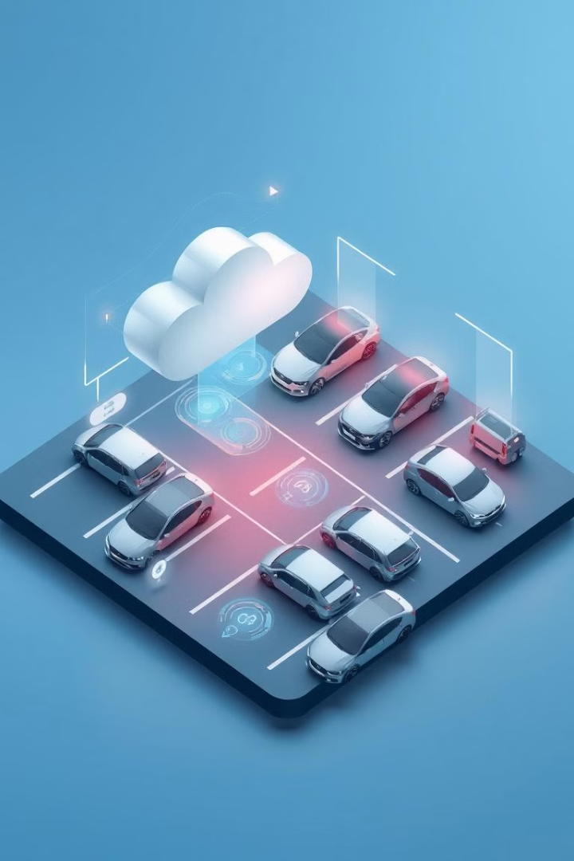



Our Real-Time Monitoring System
Space Detection
Sensors detect vehicle presence in real-time. They offer precise occupancy data.
Data Transmission
Data transmits wirelessly to a central system. It gives constant updates.
Cloud Processing
The cloud analyzes data and predicts availability. This optimizes parking.

Slide 5




Core Technology
Smart Sensors
Wireless Data
Cloud Platform
Durable sensors are embedded in each parking spot. They detect occupancy.
Wireless tech sends data to a central hub. It offers low power consumption.
Scalable cloud processes and stores data. It provides analytics.

Slide 6
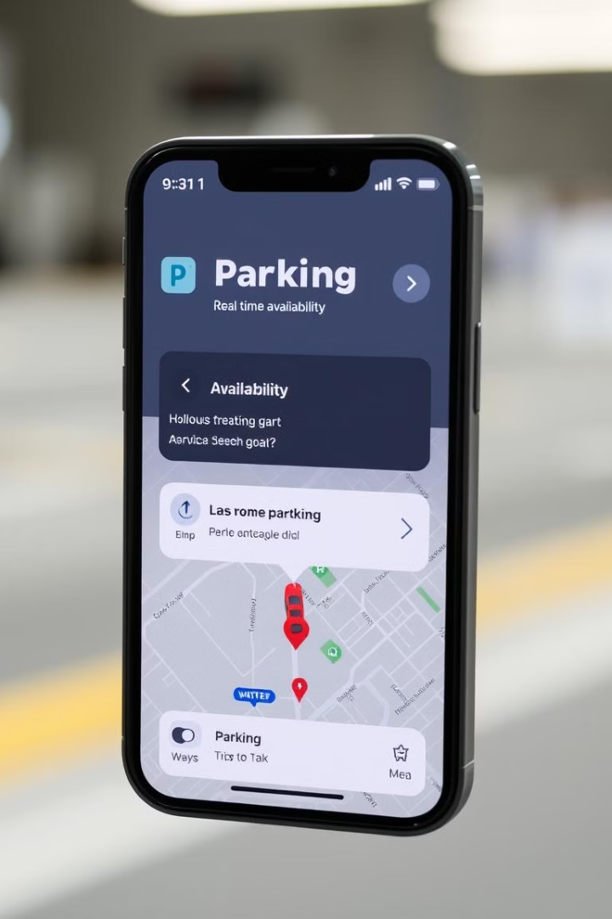
Key Features
1
Availability Updates
2
Navigation
Drivers can find available spaces instantly. They can do this via mobile app.
In-app navigation guides to open spaces. It minimizes search time.
3
Automated Billing
Seamless payments are done through the app. It provides hands-free experience.

Slide 7
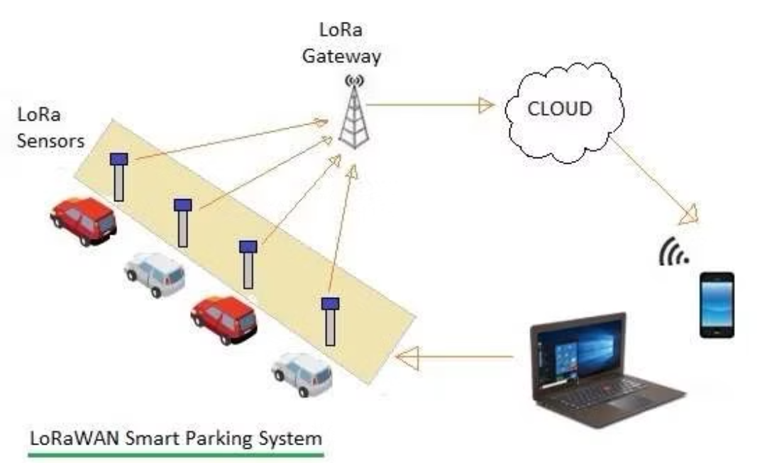
System Architecture

Slide 8
Seamless User Experience
Mobile App
Parking Lot Displays
User-friendly interface for drivers. They can easily view availability and pay.
Digital signage shows open spots at entry points. It reduces circling and confusion.

Slide 9




Implementation Strategy
Pilot Program
Data Analysis
1
Start with a small section for testing.
2
Gather data to refine the system.
Full Deployment
4
Phased Rollout
Cover all spaces after successful phases.
3
Expand to other sections gradually.
Our strategy prioritizes smooth deployment. It ensures minimal disruptions.

Slide 10
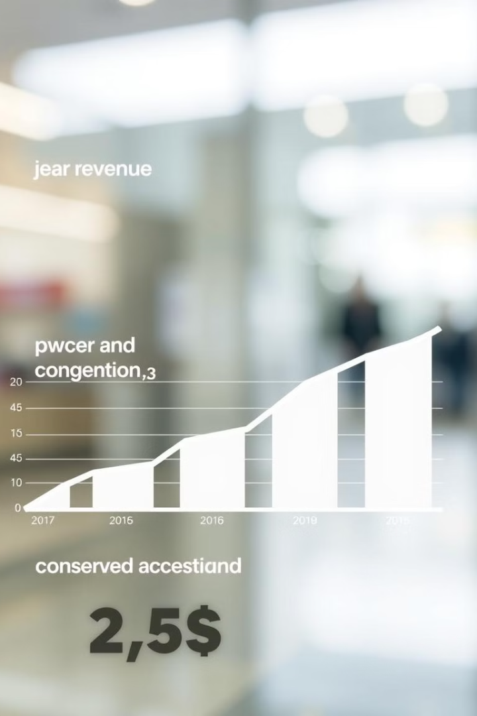
Key Benefits
Increased Revenue
Reduced Congestion
Higher occupancy and efficient billing enhance revenue.
Better space utilization and flow cut traffic.
Customer Satisfaction
Easy parking elevates the overall experience.

Slide 11
Implementation Strategy
Pilot Program
Phased Rollout
Start with a small section for testing.
Expand to other sections gradually.
1
2
3
4
Data Analysis
Full Deployment
Gather data to refine the system.
Cover all spaces after successful phases.
Our strategy prioritizes smooth deployment. It ensures minimal disruptions.

Slide 12
Conclusion
Our real-time parking solution offers a comprehensive approach to modernize parking lots. By leveraging smart sensors, wireless data transmission, and cloud processing, we provide availability updates, in-app navigation, and automated billing. The pilot program results demonstrate significant improvements in occupancy, revenue, and congestion. This system will revolutionize parking for drivers and lot owners.

Slide 13
Thank You

